Slide 1
Instagram Account Analysis
Using Machine Learning and Python to Identify Fake Accounts

Slide 2
Introduction
The analysis focuses on distinguishing between genuine and fake Instagram accounts using machine learning techniques and exploratory data analysis (EDA). By examining key features and metrics in the dataset, we can develop a model aimed at accurately classifying account authenticity.

Slide 3
Data Overview
01
Instagram accounts can be categorized as genuine, fake, or spammer based on various factors like engagement patterns, content quality, and follower growth. Genuine accounts typically have consistent interaction, authentic content, and gradual, organic follower growth. In contrast, fake accounts often display incomplete profiles, erratic growth, or bot-like behavior, while spammers tend to post repetitive or irrelevant content and exhibit automated interactions. Analyzing these characteristics using social media analytics can help identify and differentiate between account types effectively.

Slide 4
Profile Picture Binary Data
The profile picture data is represented as a binary feature, where a value of 1 indicates the presence of a profile picture and 0 signifies its absence. This feature is crucial as genuine accounts typically have profile pictures, while spam or fake accounts often do not, making this a significant factor in classification.

Slide 5
Username Characteristics
Username characteristics encompass the number of characters or digits present in the username. The length of the username can affect account authenticity; shorter or unusually formatted usernames may hint at spam accounts. Additionally, the analysis of patterns within usernames can reveal trends or commonalities among fake accounts.

Slide 6
Full Name Metrics
Full name metrics provide insight into the structure and characteristics of user names on Instagram. This feature includes two aspects: the number of words in the full name and its character length. Typically, genuine accounts have more structured and normal full names, while fake accounts might utilize unusual or random combinations of characters. Analyzing these aspects can help identify anomalies and enhance classification accuracy.

Slide 7
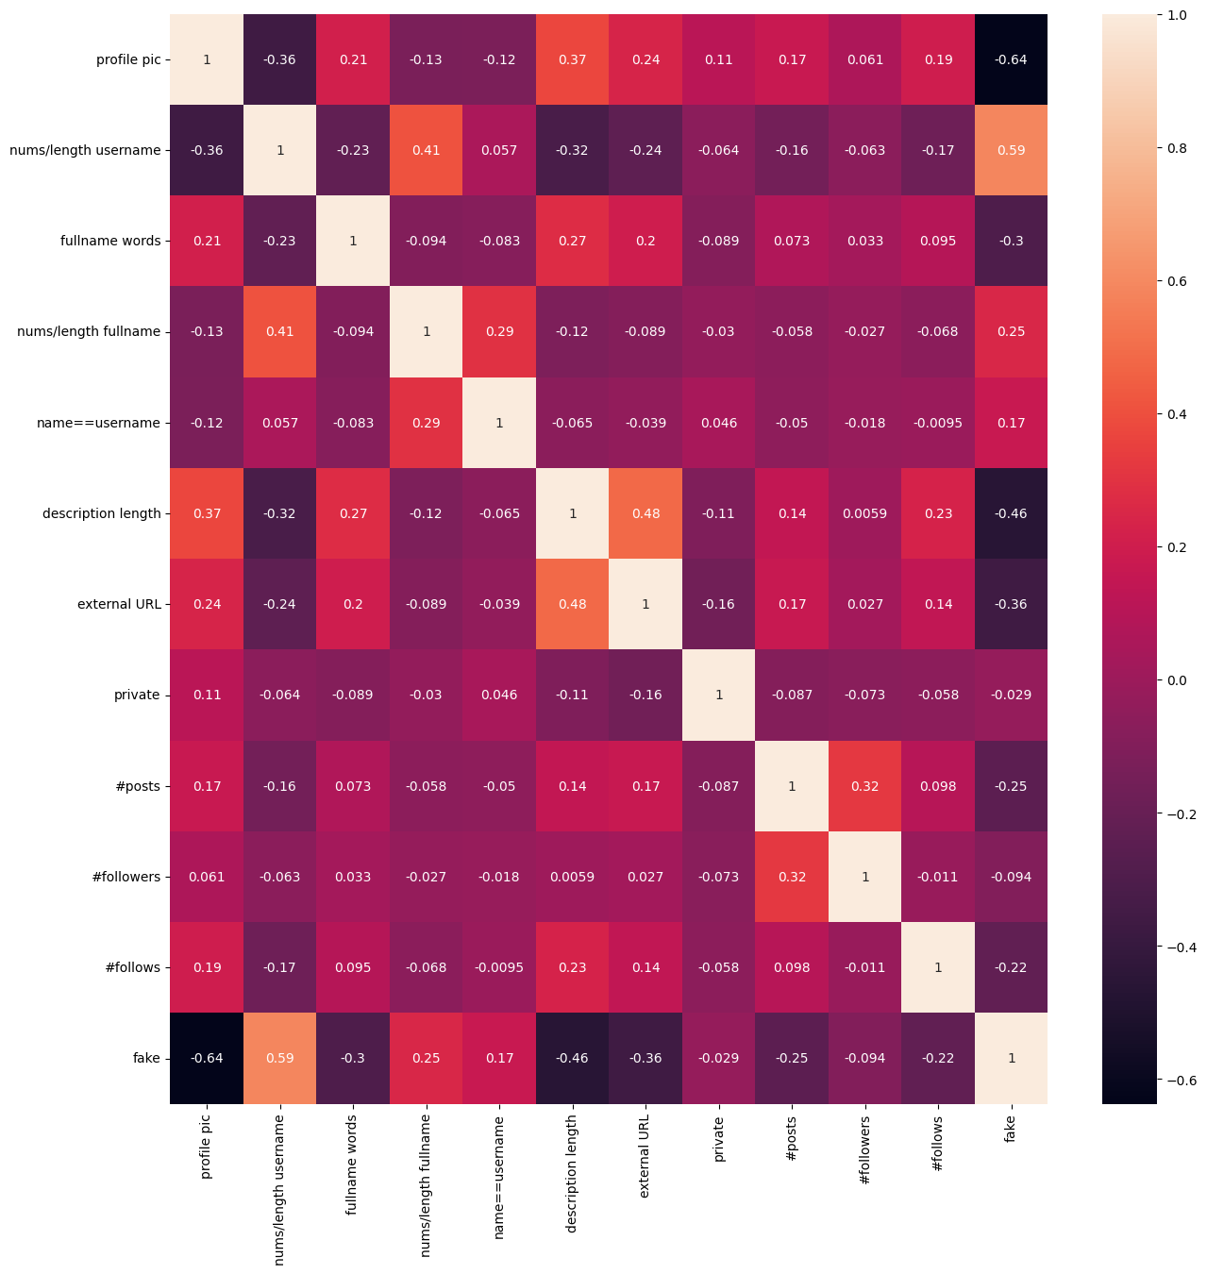
02
Model Evaluation

Slide 8
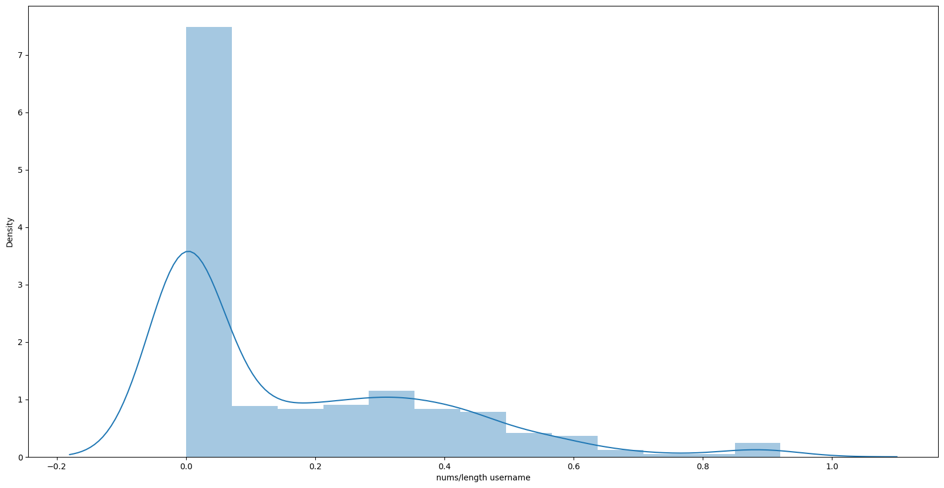
Feature Importance Analysis
Feature importance analysis identifies the most critical attributes that contribute to the classification of accounts. In the dataset, features like profile picture presence and follower count are often highlighted as significant. For instance, fake accounts may lack profile pictures and exhibit suspicious follower behavior, such as extremely low or high follower counts. Understanding these features helps refine the classification process and focus on the most telling indicators of authenticity.

Slide 9
Performance Metrics Examination
Evaluating model performance involves examining various metrics such as accuracy, precision, recall, and F1-score. Accuracy measures the proportion of correctly classified accounts, while precision assesses the correctness of positive identifications. Recall indicates the model's ability to find all relevant instances, and the F1-score provides a balance between precision and recall. Analyzing these metrics offers insights into the model's effectiveness at distinguishing between fake and genuine accounts.

Slide 10
Future Improvements Suggestions
To enhance the current model, consider adopting more sophisticated algorithms like Gradient Boosting or XGBoost, which can effectively manage complex data patterns. Furthermore, hyperparameter tuning using GridSearchCV can optimize model performance by finding the best parameter combinations. Additionally, implementing techniques to address imbalanced classes is crucial, especially if the dataset has significantly more genuine accounts compared to fake ones, thereby improving the model's robustness.

Slide 11
Conclusions
Training Data Percentage = 82.758
Testing Data Percentage = 17.241
In conclusion, utilizing machine learning and EDA for identifying fake Instagram accounts offers significant potential. By thoroughly analyzing data features, implementing effective models, and continuously improving methodologies, we can enhance the accuracy of classifications. This analysis not only aids in understanding account authenticity but also contributes to creating a safer social media environment.

